Slide 1
Inventra – Intelligent Inventory Management System
Presented By Team 2
Christina J Krishna Moorthy Anbalagan Rajeshwari R
Shrisha Singha
Ganji Sudharsan Balaji

Slide 2
INTRODUCTION
Inventory management is a critical function for organizations dealing with products and stock.
Manual or poorly designed inventory systems often lead to issues such as duplicate products, incorrect stock levels, and lack of transaction tracking.
With multiple users accessing the system simultaneously, problems like data inconsistency and stock mismatch can occur.
Inventra – Intelligent Inventory Management System is designed to solve these challenges by providing a secure, reliable, and automated inventory solution.
The system uses modern web technologies and Java-based backend frameworks to ensure data consistency, security, and scalability.

Slide 3
PROBLEM STATEMENT
Many organizations rely on manual or semi-automated inventory systems, which are prone to human errors.
The same product may be stored multiple times with different names or identifiers, leading to duplicate inventory records.
Lack of proper transaction tracking results in incorrect stock levels and poor accountability.
Concurrent access by multiple users can cause data inconsistency and negative stock values.
Traditional systems often lack security, role-based access control, and real-time alerts, increasing operational risk.

Slide 4
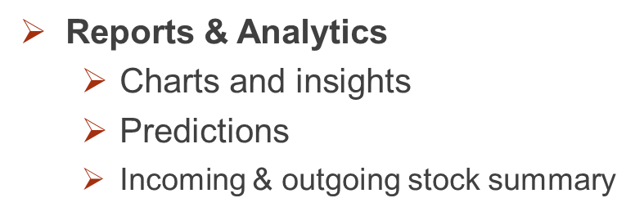
PROPOSED SYSTEM
Modules of Inventra:
Authentication
Login, token generation, role validation
Product / Inventory Management
Add, update, delete items
Track stock levels
Store supplier details, purchase history
Inventory Alerts
Low stock alerts
Expiry-near alerts
Fast and slow-moving items detection
Transaction Management
Record stock-in and stock-out operations
Maintain complete transaction history
Ensure data consistency and auditing

Slide 5
TECHNOLOGY STACK
Development Tool
IntelliJ IDEA
Frontend
HTML
CSS
JavaScript
Backend
Java
Spring Boot
REST API
Security
JWT
Bcrypt
Role-Based Access Control (RBAC)
Database
MySQL

Slide 6
SYSTEM ARCHITECTURE
The system follows a Controller – Service – Repository architecture.
Controller Layer
Handles client (UI) requests
Exposes REST APIs
Service Layer
Contains business logic
Manages transactions and validations
Repository Layer
Handles database operations
Interacts with MySQL using JPA
Ensures clear separation of responsibilities, maintainability, and scalability

Slide 7
Module 1: Authentication Module
Module Description
This module ensures only authorized users can access the
system,. It manages login, logout, roles, and security tokens.
Classes
User: Stores user details in the DB
AuthController: Handles API endpoints (/login, /register)
AuthService: Authentication logic & error handling
JwtProvider: Creates secure tokens
UserRepository: Interacts with database for CRUD operations

Slide 8
Workflow of Module 1 – Authentication
User/Admin submits credentials
AuthController receives request
AuthService validates and encrypts password
User data stored in database
User logs in with credentials
System verifies user
JWT token is generated
Token validated for every request
Role-based access enforced

Slide 9
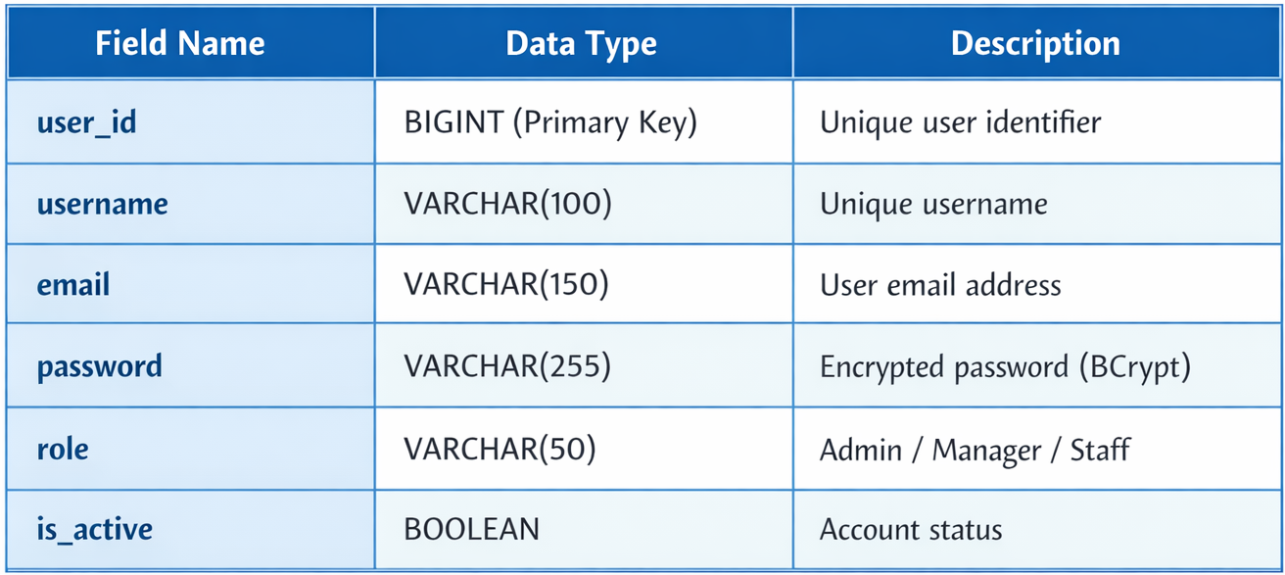
Database Schema (Authentication Module)

Slide 10
MODULE 2 – PRODUCT / INVENTORY MANAGEMENT
MODULE 2 – PURPOSE
Classes Involved
Product
Category
Supplier
Inventory
ProductController
ProductService
ProductRepository
TransactionService
Store product details in the system
Maintain accurate inventory records
Handle stock received in multiple shipments
Display current available stock at any time

Slide 11
Inventory / Product Management – Workflow
User logs into the system with valid credentials.
User sends a request to add a new product or update stock.
Request reaches the ProductController.
Controller forwards the request to ProductService.
ProductService checks for duplicate product (using SKU).
Stock is increased or decreased based on the operation.
Product data is saved using ProductRepository.
Transaction details are logged in TransactionService.
Low stock is checked and alert is triggered if required.
Updated inventory status is sent back to the user.

Slide 12
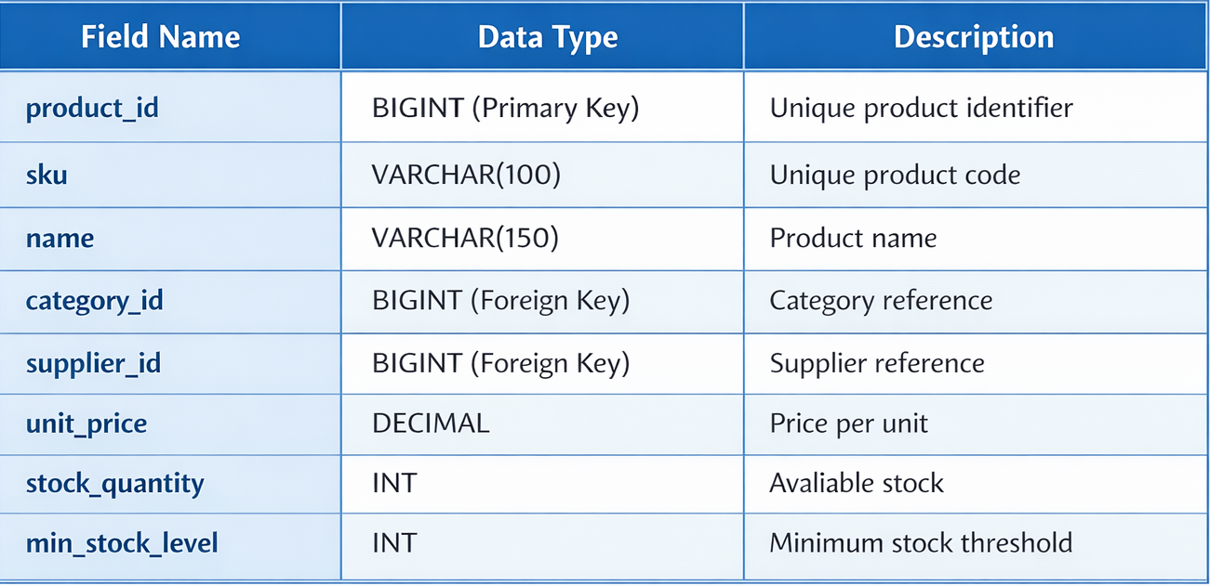
Database Schema (Inventory / Product Management )

Slide 13
MODULE 3 – ALERTS & MONITORING
MODULE 3 – PURPOSE
Classes Involved
Alert
AlertService
NotificationService
Monitor system conditions continuously
Detect warning and critical situations
Generate alerts to notify users
Support timely decision-making

Slide 14
Inventory Alerts– Workflow
Stock quantity is updated in the inventory module.
The ProductService calls the AlertService after stock change.
AlertService compares current stock with minimum stock level.
If stock is below the minimum level, an alert is generated.
Alert information is sent to the NotificationService.
NotificationService displays alert on dashboard or sends email/SMS.
User is notified about low stock condition.

Slide 15
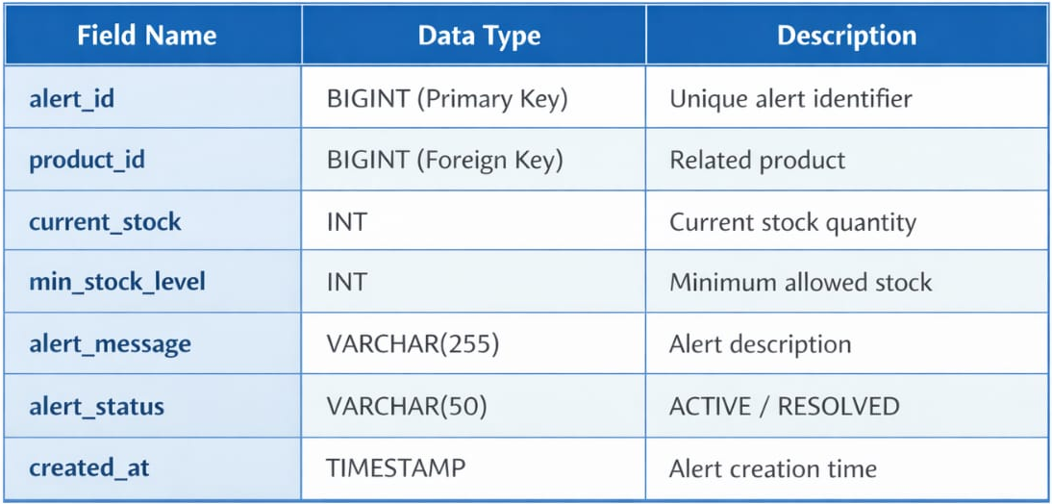
Database Schema (Inventory Alerts)

Slide 16
MODULE 4 – Transaction Management
MODULE 4 – PURPOSE
Classes Involved
To maintain a complete record of all inventory transactions
To track stock-in and stock-out activities
To ensure data consistency and accountability
To support audit and verification of inventory operations
To help in report generation and analysis
Transaction
TransactionService
TransactionRepository

Slide 17
Transaction Management– Workflow
User performs a stock-in or stock-out operation.
Request is processed by ProductService.
After stock update, TransactionService is invoked.
TransactionService creates a new transaction record.
Transaction details (type, quantity, user, date) are stored.
Data is saved using TransactionRepository.
Transaction history is available for reports and audits.

Slide 18
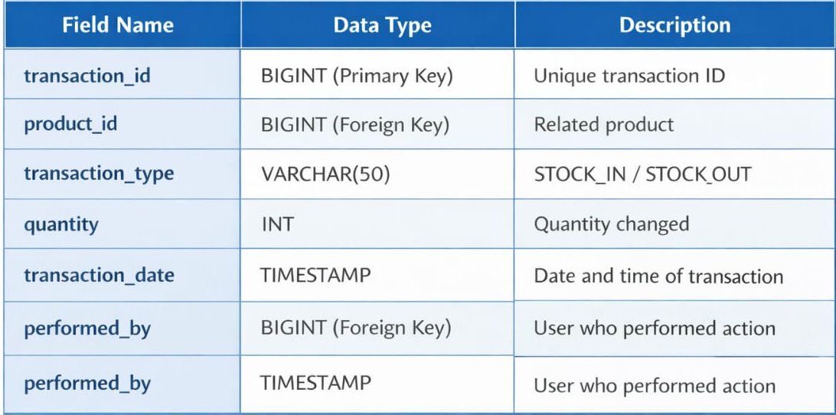
Database Schema (Transaction Management)

Slide 19
MODULE 5 – Reports & Analytics
MODULE 5 – PURPOSE
Classes Involved
Generate inventory and transaction reports
Provide insights for decision making
Support audit and management review
ReportController
ReportService
ExportService

Slide 20
Reports & Analytics– Workflow
User requests a report through the dashboard
Request is sent to the ReportController
ReportController forwards request to ReportService
ReportService fetches inventory and transaction data
Filters are applied (date, product, type)
Report is generated and returned to the user
Report can be viewed or exported if required

Slide 21
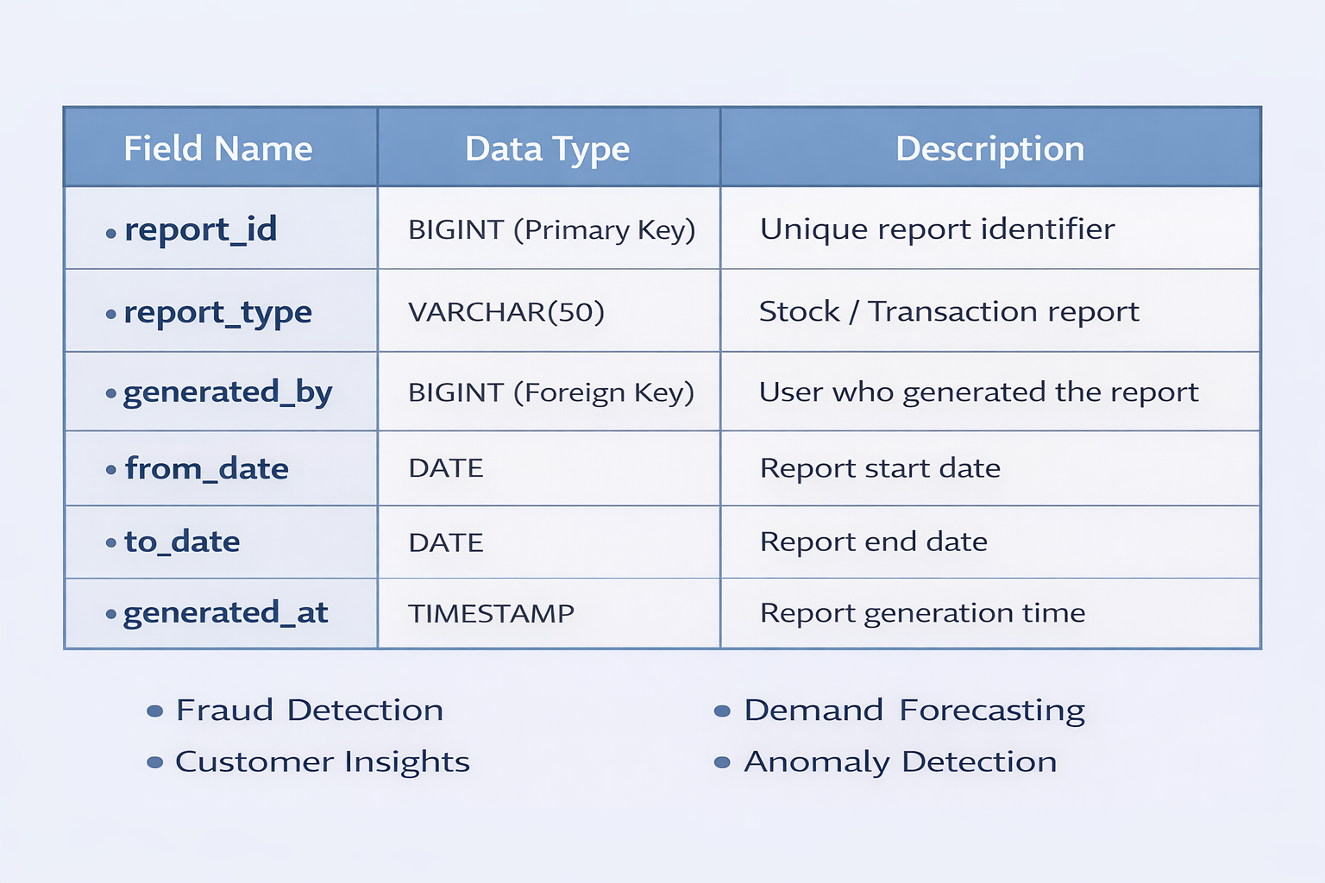
Database Schema (Reports & Analytics)

Slide 22
Key Features & Advantages
Secure authentication with role-based access control
Accurate and real-time inventory management
Automatic low-stock alert generation
Complete transaction history for auditing
Improved data consistency and reliability
Reduced manual errors and better decision making

Slide 23
Conclusion
Inventra provides a secure and efficient inventory management system.
The system ensures accurate stock tracking, automated alerts, and complete transaction history.
Role-based authentication improves system security and access control.
The modular architecture makes the system scalable and easy to maintain.

Slide 24
THANK YOU

